Slide 1



Crypto CRIME
What do the numbers actually say?
& PRICE ANALYSIS

Slide 2


Compare the price analysis of 4 MAJOR Cryptocurrencies
PROJECT LONG TERM PRICE PREDICTIONS
COMPARE BITCOIN, FULL CRYPTO MARKET VS THE US DOLLAR CRIME RATE ANALYSIS.
RESEARCH QUESTION #1: WHAT CRYPTOCURRENCY IS LIKELY TO STABILIZE AND COMPETE WITH FIAT?
RESEARCH QUESTION #2: WHICH IS USED MORE FOR CRIME BITCOIN, CRYPTO MARKET OR THE US DOLLAR?

Slide 3


Slide 4


THE TOP TWO CRYPTOCURRENCIES BY MARKET CAP:
BITCOIN
ETHER

Slide 5
Task Breakdown:
COMPILE DATA FOR FOUR CRYPTO CURRENCIES QUARTERLY FOR 3 YEARS TO DETERMINE WHICH COIN HAS THE BEST CHANCE TO STABILIZE AND COMPETE WITH FIAT CURRENCY.
COMPILE CRIME DATA FOR BTC, THE CRYPTO MARKET AND THE US DOLLAR AND USE PLOTS TO SHOW CRIME DATA OVER THE PAST YEAR.

Slide 6


Slide 7
ACCORDING TO GOVERNMENTS AROUND THE WORLD…
BITCOIN AND ALT COINS ARE USED IN MORE CRIME THAN FIAT (NON-DIGITAL) CURRENCIES…
AS THEY TRY TO IMPLEMENT REGULATIONS ON CRYPTOCURRENCIES

Slide 8
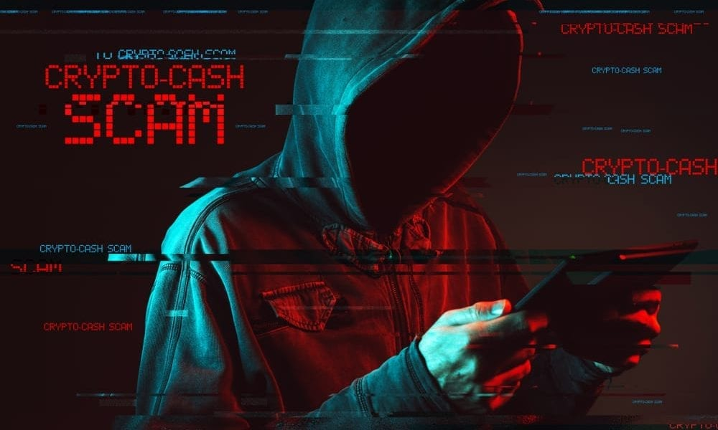

Slide 9
ACCORDING TO THE DATA IN OUR REPORT…
WE WILL SHOW HOW THIS IS
NOT TRUE

Slide 10

web 3.0…

Slide 11
Ethereum is a digital economic platform that uses ether and other erc 20 tokens and coins to create a digital economy
Ether is the second largest cryptocurrency behind bitcoin & the most likely to stabalize and compete with fiat currency

Slide 12


Slide 13
Ethereum classic is an open-source, decentralized, blockchain-based distributed platform that runs smart contracts....
Based on the principle of “code is law,” smart contracts are self-executing autonomous digital applications, which are capable of running on their own as programmed.

Slide 14
Ethereum classic has potential limitations when it comes to scalability as opposed to Ethereum
Ethereum classic was hacked in 2019, causing it to substantially fall behind it’s bigger brother Ethereum…
However, Ethereum classic still has a loyal following

Slide 15


Slide 16
Litecoin is a peer-to-peer cryptocurrency and open-source software released under the mit/x1project1 license.
Litecoin was an early Bitcoin spinoff or altcoin, starting in October 2011.
In technical details, Litecoin is nearly identical to Bitcoin
Litecoin is yet to establish the following that Bitcoin has amassed

Slide 17


Slide 18
Then there are the alt coins…
Which are everything but Bitcoin
Alt coins have large and loyal followings
Almost as large as Bitcoin

Slide 19
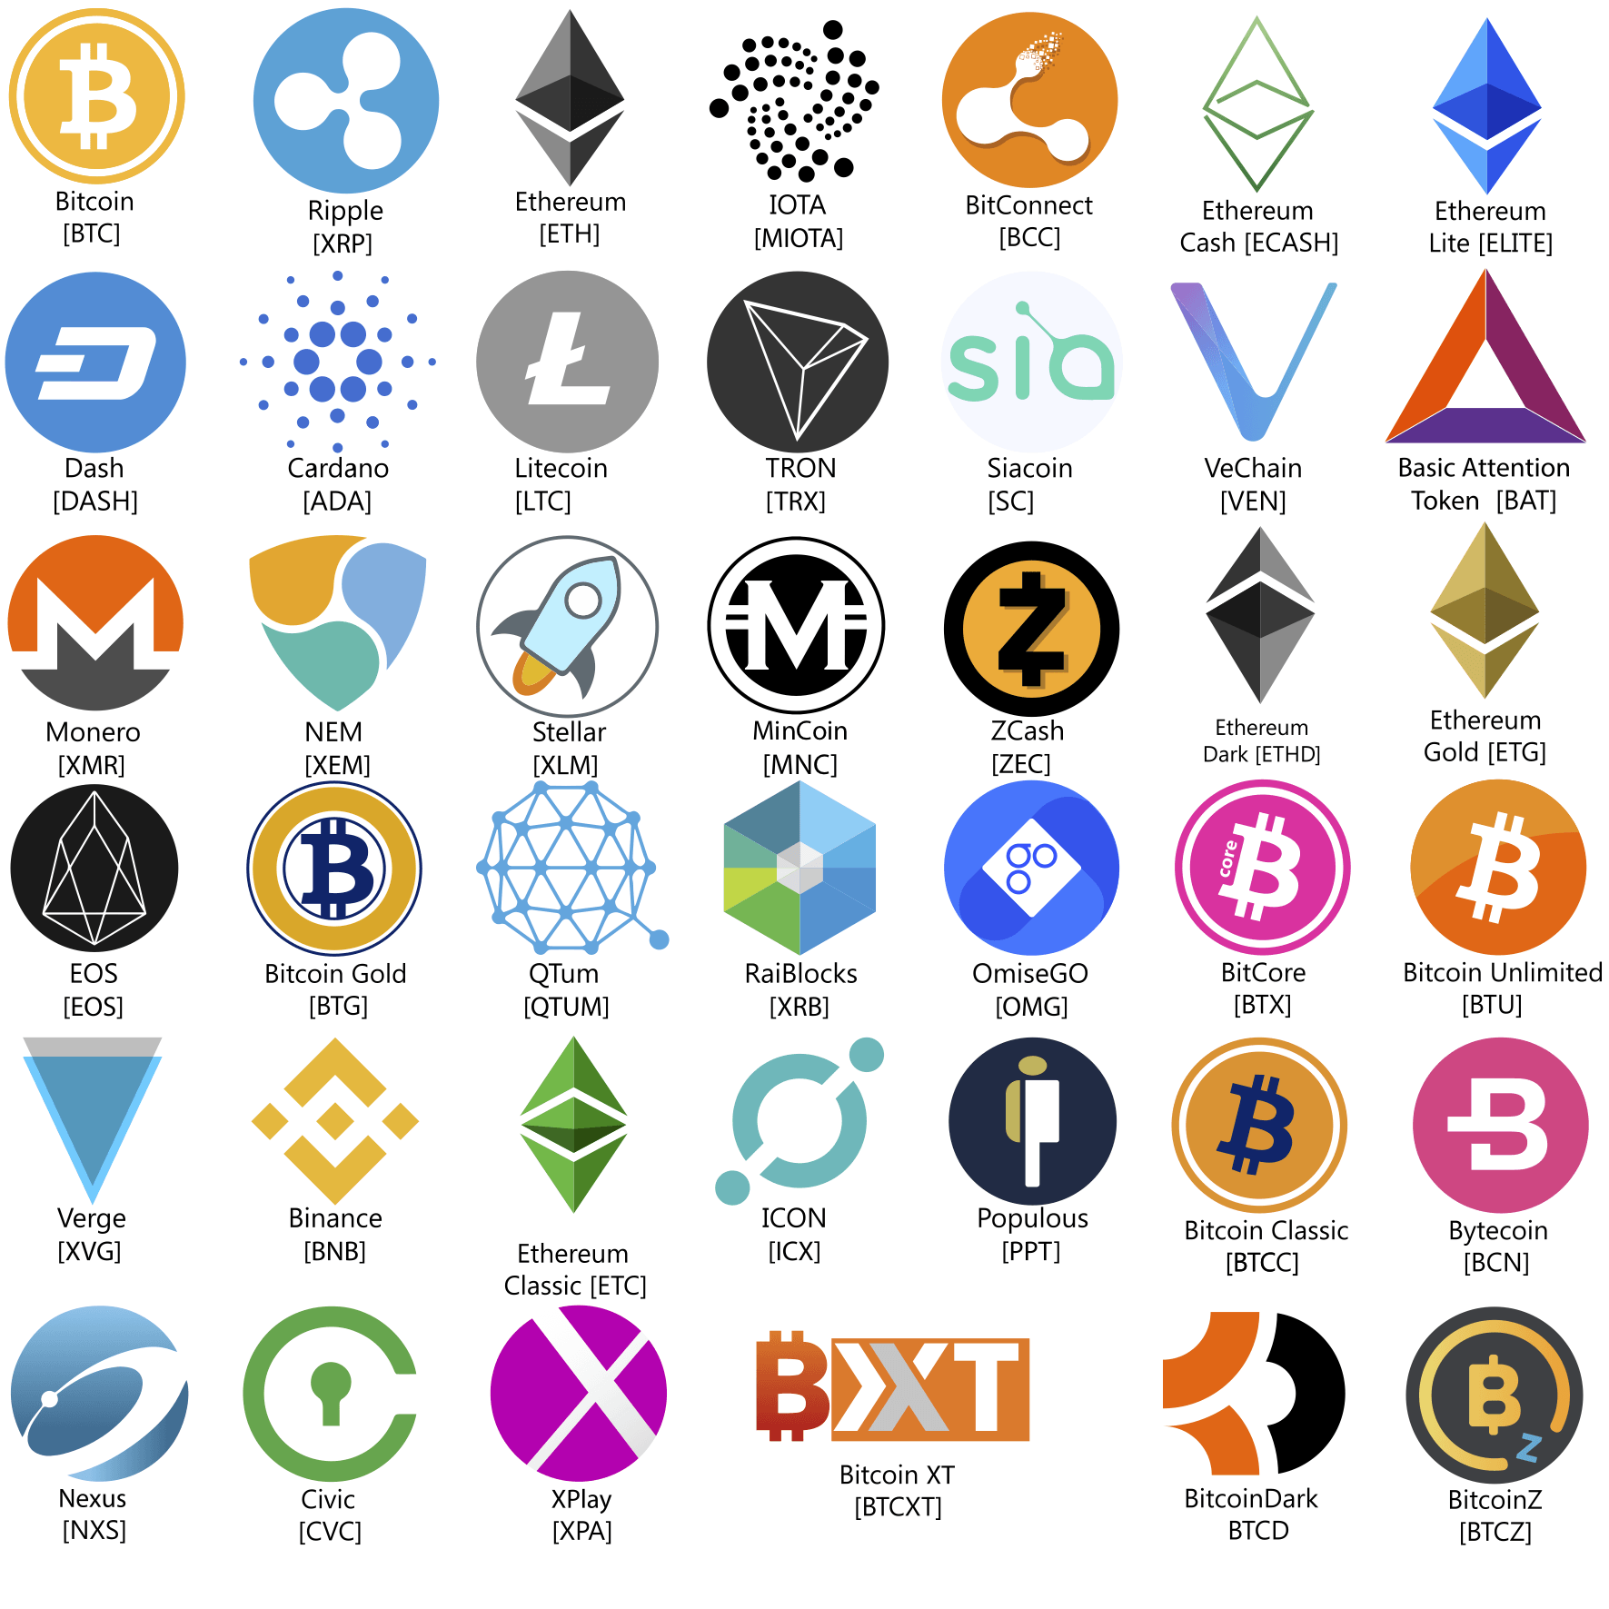
The thing is…
There are a lot of alt coins.

Slide 20

LIKE, A LOT….

Slide 21


Slide 22
Monero is an untraceable privacy coin that is quickly rising in popularity amongst criminals posing a problem for law enforcement as well as crypto investors
Monero is a niche privacy coin, designed to obscure the sender and receive, as well as the amount exchanged, making it nearly impossible to track transactions

Slide 23
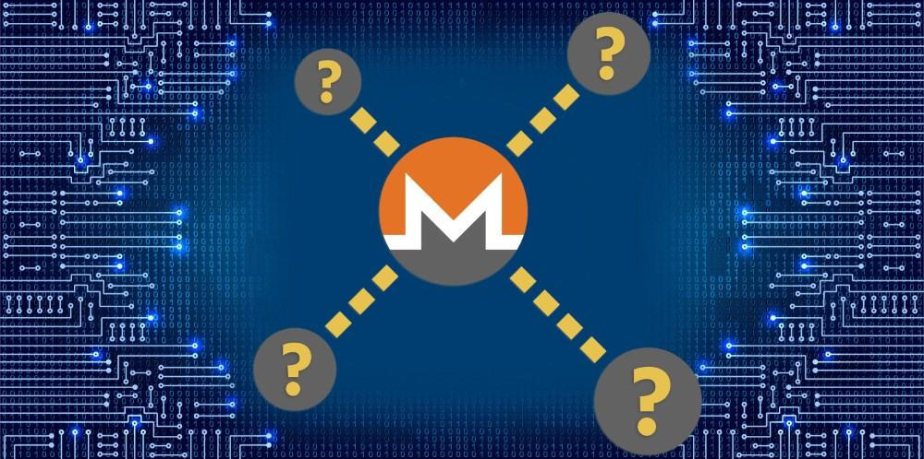

Slide 24
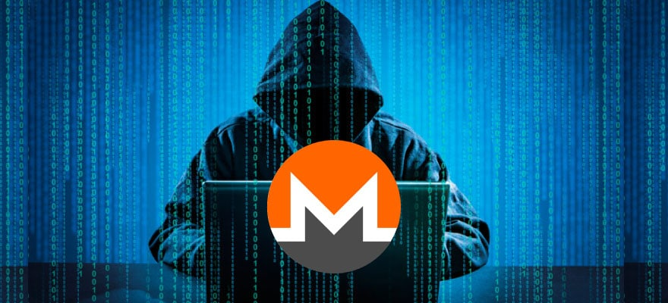
MONERO DOES NOT
BITCOIN AND ALL OTHER ALT COINS LEAVE A VISABLE TRAIL OF TRANSACTIONS ON THEIR INDIVIDUAL BLOCKCHAINS…

Slide 25

THE END

